Slide 1

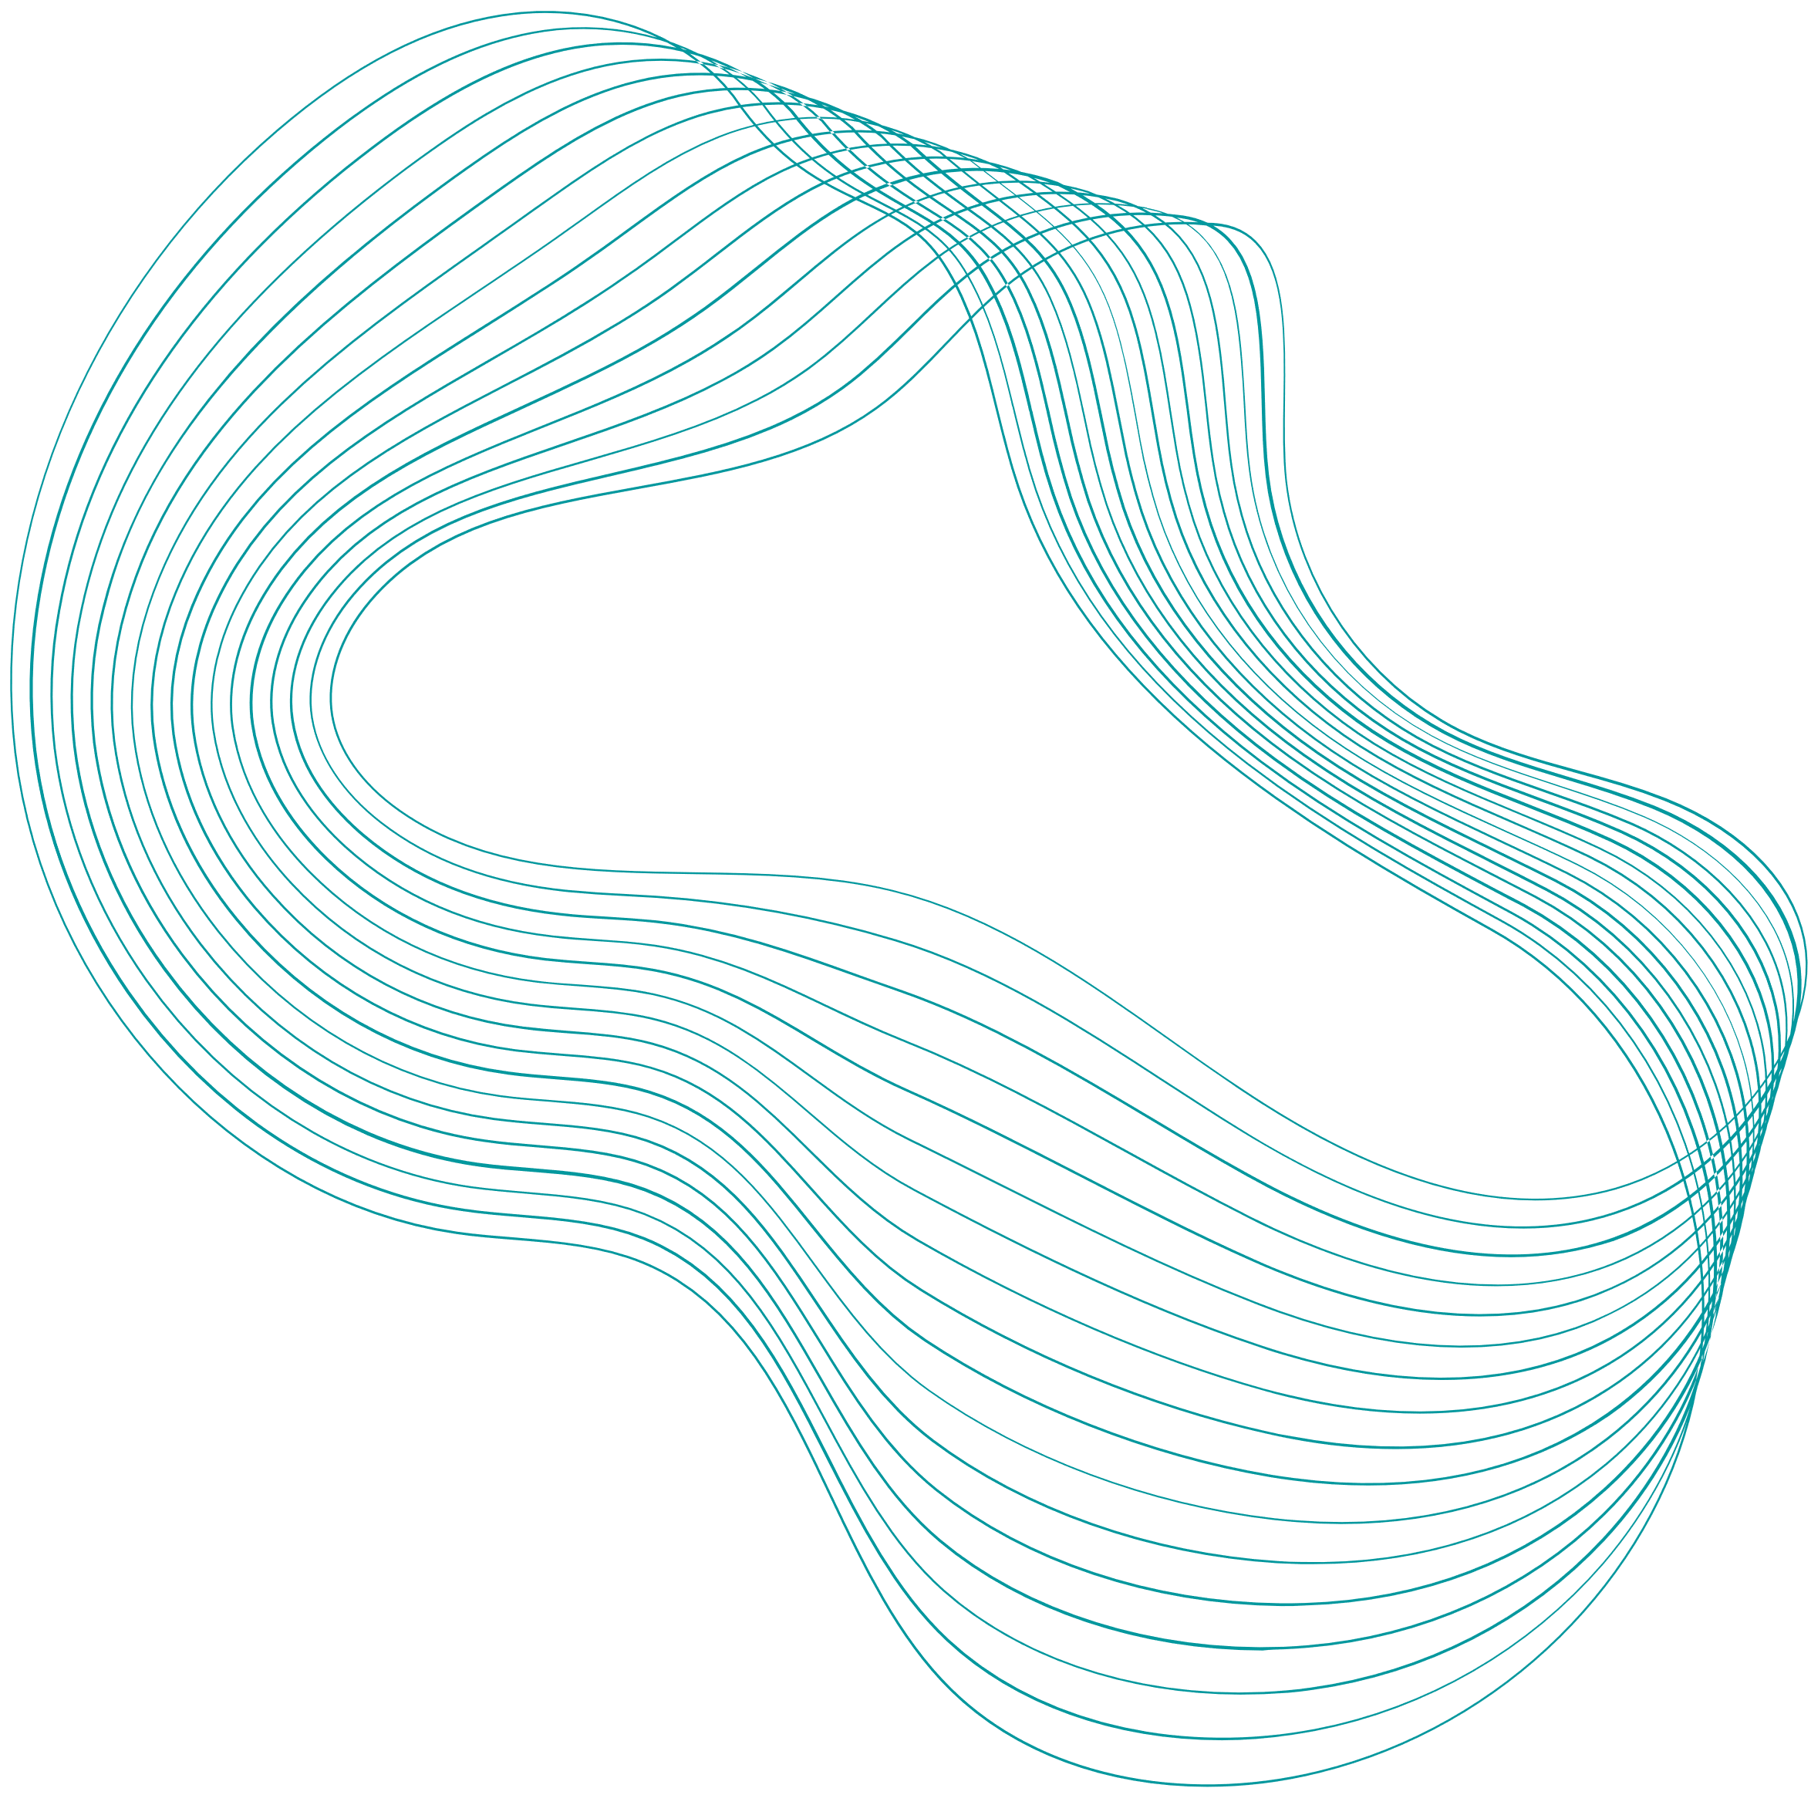
01
FPS AND OVERCLOCKING
Vishal S. Deshmukh
PRN: 10303320181124513007

Slide 2

Introduction to FPS and Overclocking
FPS and Hz
-Key points
03
CONTENTS
04
05
08
Overclocking
-Key points
09
11
Advantages
12
Disadvantages

Slide 3
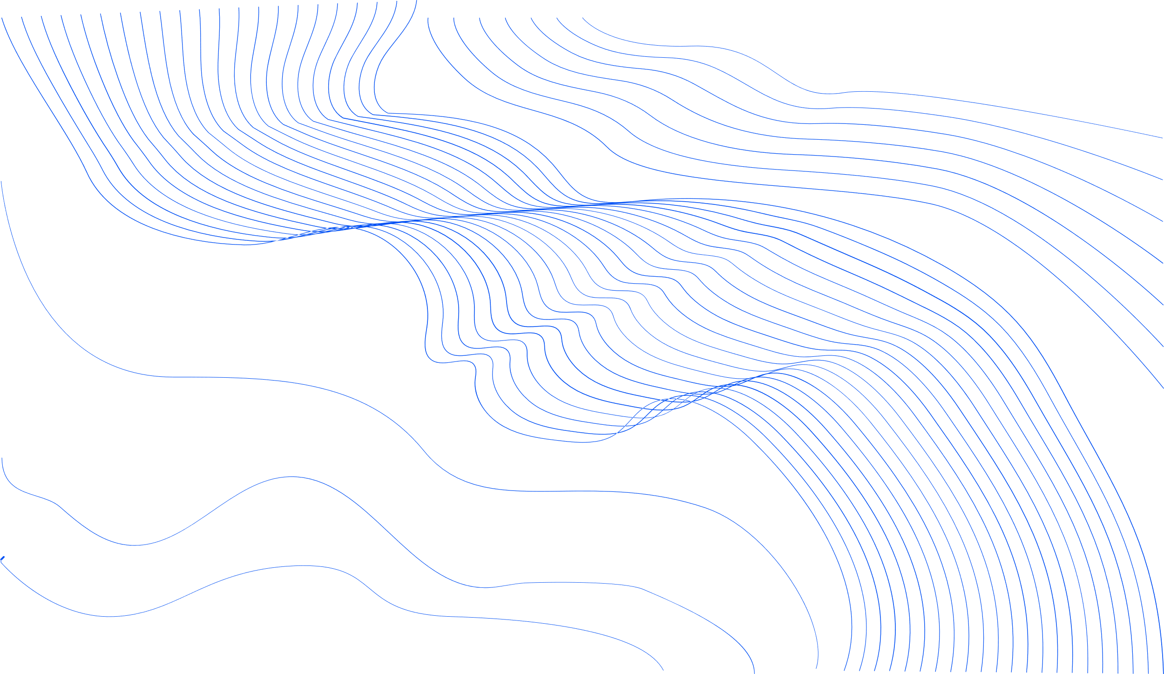
INTRODUCTION TO
FPS AND OVERCLOCKING
03
FPS - Stands for "Frames Per Second." FPS is used to measure frame rate – the number of consecutive full-screen images that are displayed each second.This is the number of times the image on the screen is refreshed each second, or the rate at which an imaging device produces unique sequential images called frames.
OVERCLOCKING - Overclocking is the action of increasing a component’s clock rate, running it at a higher speed than it was designed to run.Overclocking often requires other aspects of device to run outside of the specification, what happens is that device becomes unstable as we turn up the speed but that can be compensate by turning up voltage

Slide 4

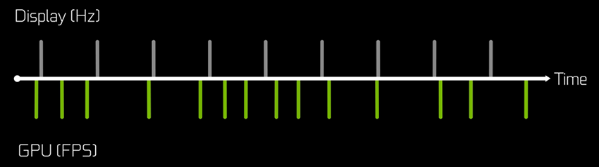
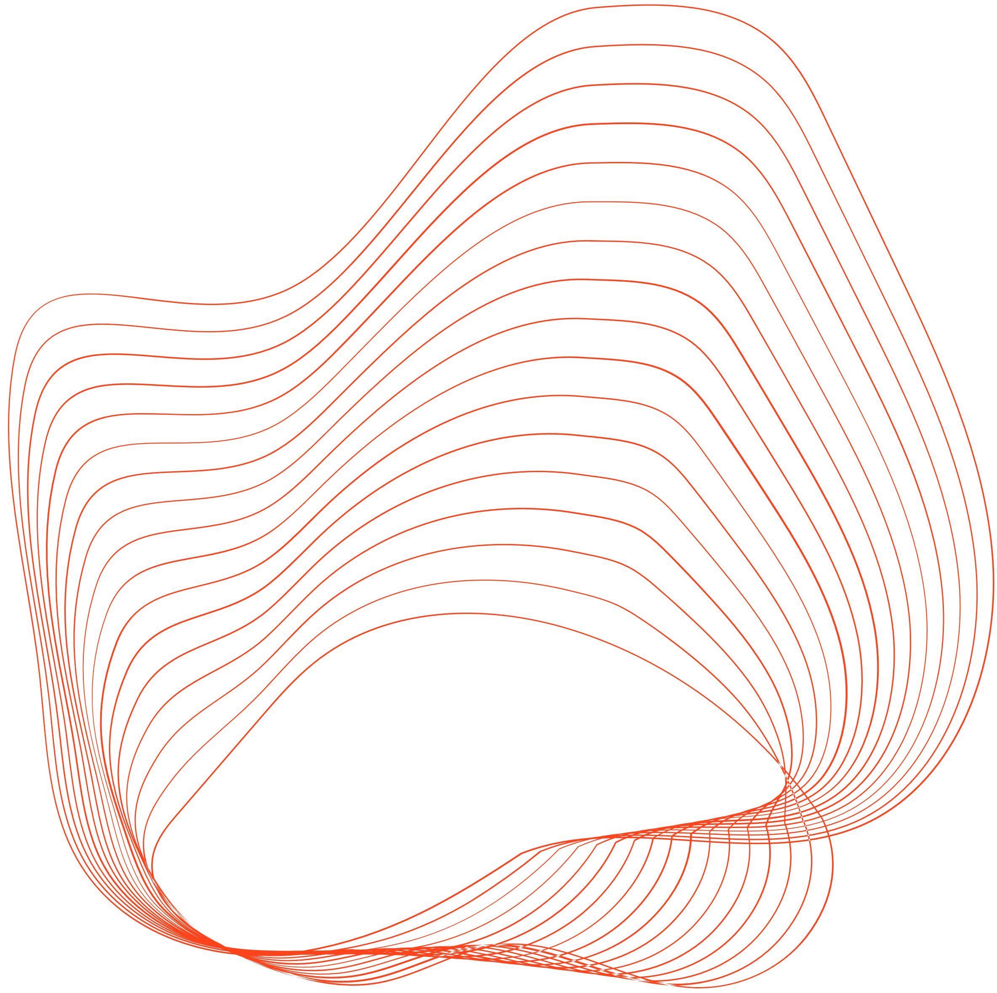
FPS and Hz
They both describe a completion rate, but by different components in your PC’s rendering system.
FPS is the rate at which your system, and in particular, your GPU completes frames
Hz is the rate at which your display shows those completed frames.
The GPU can complete frames faster or slower than the display can show them.
Hz on the other hand generally a constant rate and does not vary based on scene complexity.
04

Slide 5

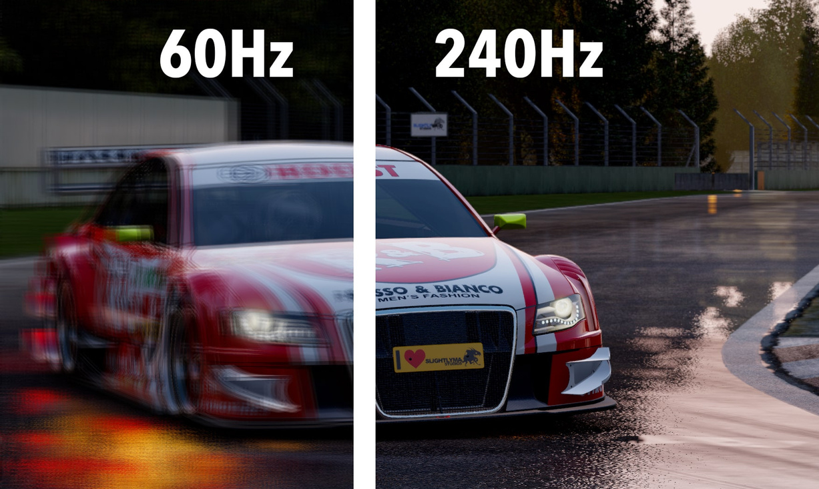
KEY POINTS :
05
Smoother Animations with High FPS
Reduced Ghosting with Higher FPS/Hz
Reduced Tearing with High FPS
High FPS = Lower System Latency

Slide 6
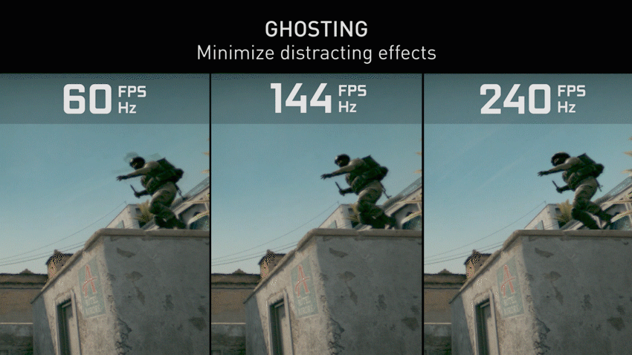
Ghosting is a distracting effect that happens on all LCD type displays. When the display refreshes, the colors do not change instantly. There is some time needed for the pixels to change, especially when the range of color change is large.
This is why at higher FPS/Hz, rotating your character or viewing an object in motion is much clearer.
Similar to the benefits of animation smoothness, reduced ghosting provides clearer target tracking - helping your eye focus on the target and not the ghost.
06

Slide 7
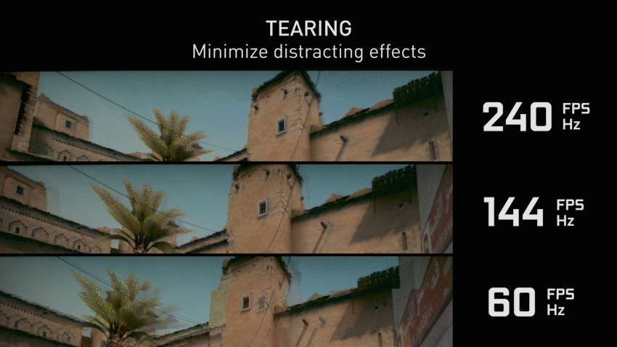
Tearing occurs when the output rate of the GPU (FPS) does not match the display’s Hz.
In order to avoid tearing, we can turn on V-SYNC.
V-SYNC effectively locks the output rate of the GPU to the Hz of the display.
07

Slide 8
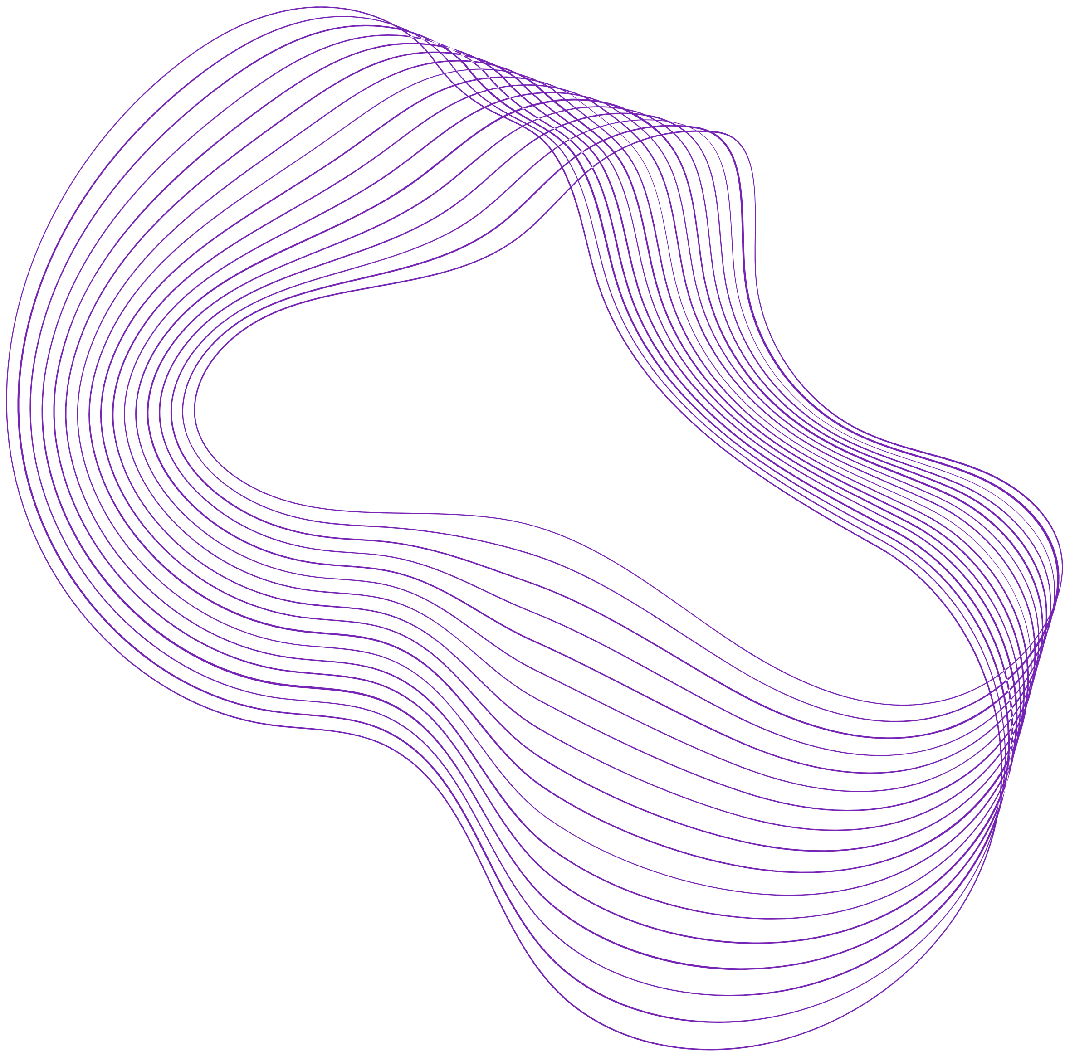
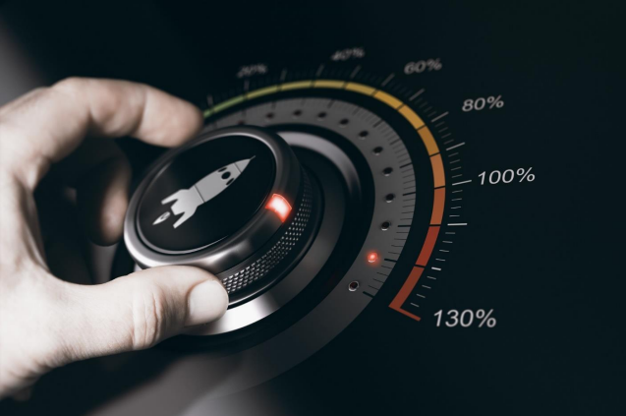
OVERCLOCKING
08
Overclocking refers to pushing your computer components harder and faster than the manufacturer designed them to go.
Overclocking can be differentiated as CPU overclocking and GPU overclocking
It’s the process of setting your CPU or GPU multiplier higher so the chip speeds up and increases your PC’s overall performance.
It’s a common way to amplify performance.
There is no one rule in how fast you can speed up a processor, but every overclocking project produces different results.

Slide 9
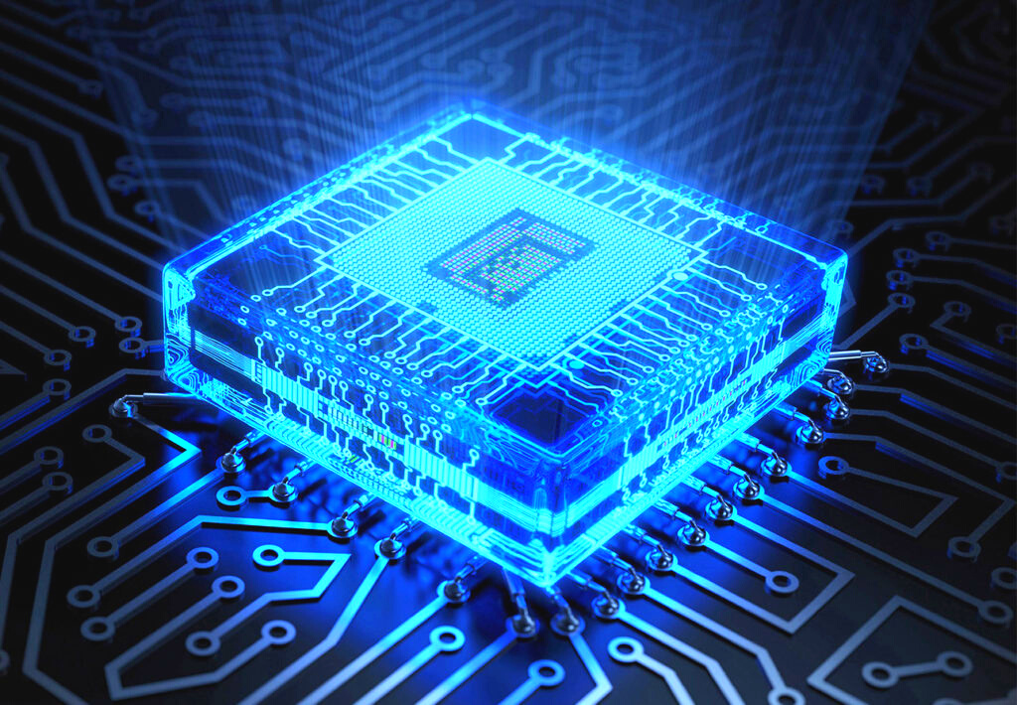
KEY POINTS:
09
CPU Overclocking
GPU overclocking
is Overclocking worth it?

Slide 10

10
Advantage:
Higher performance in games, en-/decoding, video editing and system tasks at no additional direct monetary expense. It can be cheaper to purchase a lower performance component and overclock it to the clock rate of a more expensive component. In order to setup the upgrade, the labor cost is almost zero.

Slide 11
Disadvantage:
11
Higher clock rates and voltages increase power consumption, also increasing electricity cost and heat production.The lifespan of semiconductor components may be reduced by increased voltages and heat.Warranties may be voided by overclocking Fan noise: High-performance fans running at maximum speed used for the required degree of cooling of an overclocked machine can be noisy

Slide 12
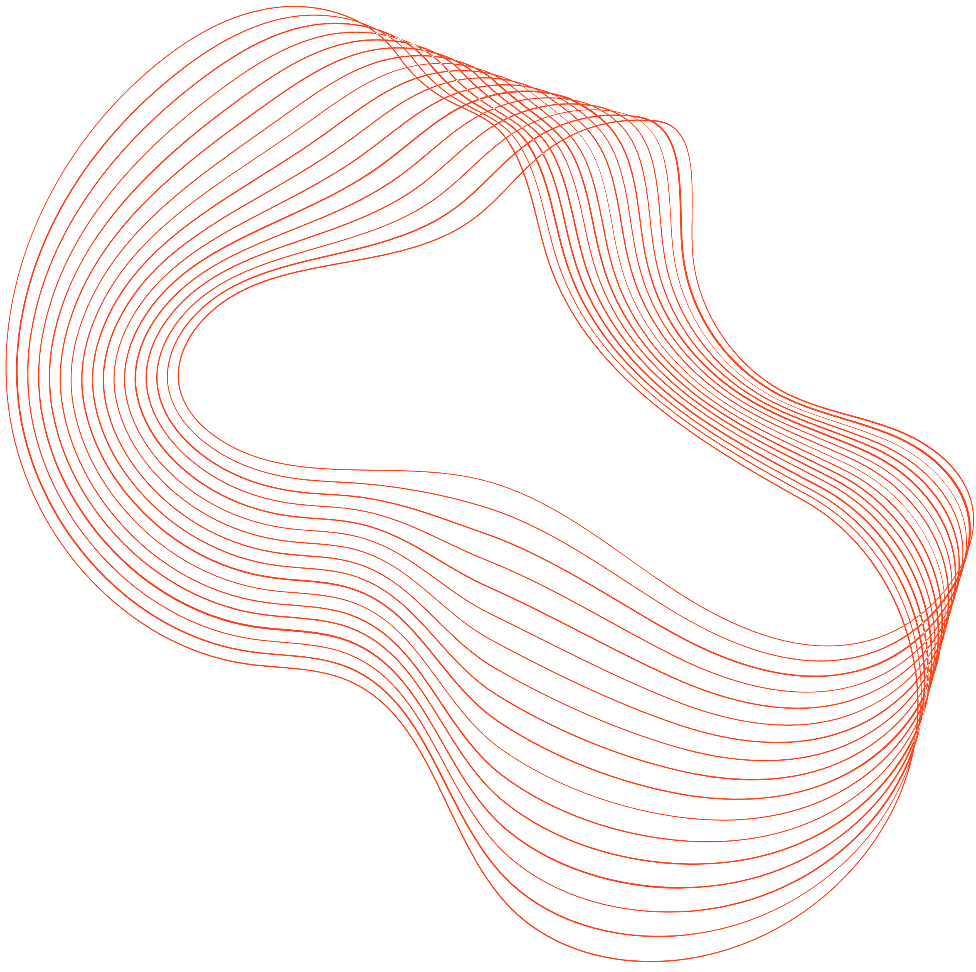
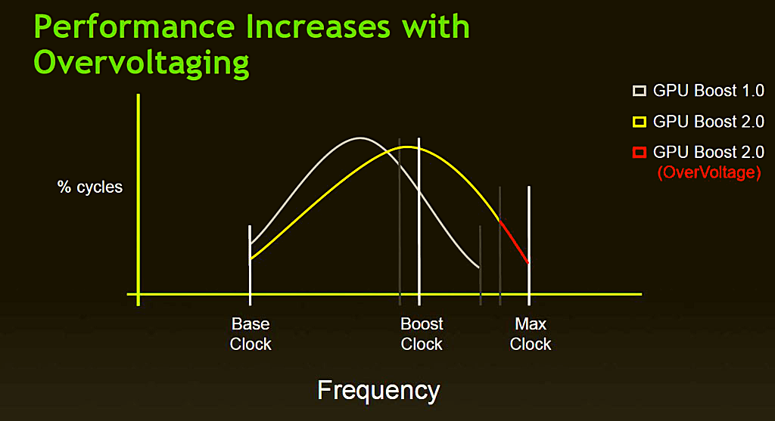
12
Changes in performance after overclocking
OVERCLOCK

Slide 13

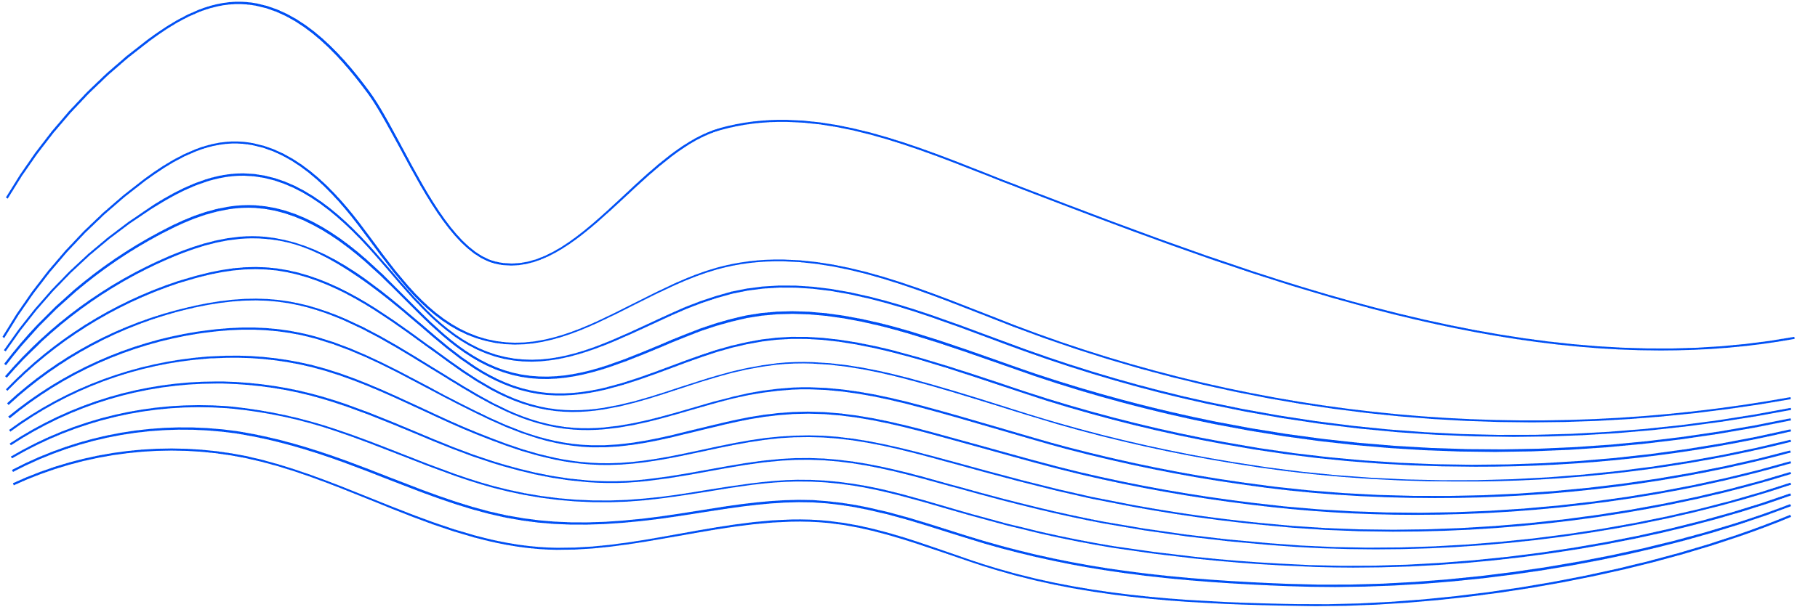
13
THANK YOU

